Slide 1

A website that books jobs
Proposal for [Business name]
Plus a monthly Google plan to keep the phone ringing. Prepared by Locate Digital, [Month 2026].
Notes:
Open with the outcome: a site that turns local searches into booked jobs, and a plan to keep it busy. Swap [Business name] and the month before sending.

Slide 2

Most local jobs are won on Google, before anyone picks up the phone
Where you are now
Hard to find
Slow to book
Missed calls
Reviews unseen
No page for the suburb or the job, so Google shows someone else.
Customers want to book at 9pm, not wait for you to call back.
On the tools all day, so calls go to voicemail and the job goes elsewhere.
Your Google reviews don’t follow people onto your website.
Website and Google proposal
02
Notes:
Tailor this to what you found when you looked them up: no site, an old site, no suburb pages, few reviews showing. Keep it to the four that apply most. Ask: when a job comes in after hours, what happens to it today?

Slide 3

The website
Part one
Built for tradies, live on your own domain in 10 working days.
Website and Google proposal
03
Notes:
Part one is the website itself. Keep this slide brief and move straight to what’s on it.

Slide 4
Every page a customer needs to choose you
What you get
Home page
Trade pages
Service pages
A job search, your reviews and a Book button on the first screen.
One for each trade you offer, listing every service you do.
Your best earners, like hot water or switchboards, one page each.
Suburb pages
Landlords
Emergency
A page for each suburb you cover, written for the homes there.
A booking path for rentals, with tenant details built in.
Your 24/7 number and what to do while they wait for you.
Website and Google proposal
04
Notes:
Walk the pages in the order a customer meets them. Drop Landlords or Emergency for a tradie who doesn’t do rentals or after-hours work.

Slide 5
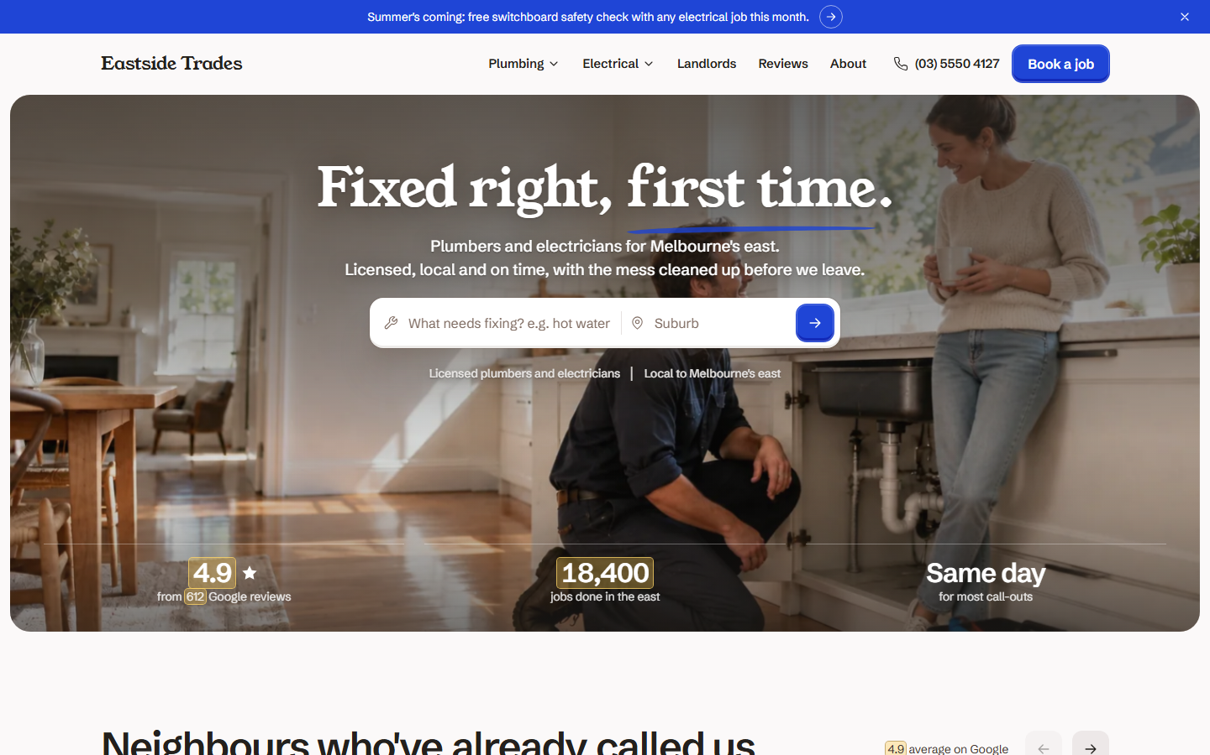
Try the live demo on your phone
demo.locatedigital.io/tradie
See it working
Open demo.locatedigital.io/tradie and book a test job.
A booking takes under a minute
One-tap calling on every phone
Your version uses your real reviews, suburbs and photos
Website and Google proposal
05
Notes:
Hand them your phone or send the link during the call. Get them to search for a job and book it. For a warm prospect, build their own version first (their name, suburbs and reviews) and show that instead.

Slide 6

From a Google search to a booked job
How it works
Every step happens on the site you’d be getting.
Searches Google
Books online
A booked job
Finds your suburb page
You text back a time
Each booking reaches your inbox straight away, with the job, suburb, photos and mobile number.
Website and Google proposal
06
Notes:
The site doesn’t send texts on its own. The booking arrives by email and the tradie texts back a time. If they want automatic texts, that’s the SMS add-on. Say this plainly so nothing is over-promised.

Slide 7
suburbs with a page of their own
16
Up to 16 in the build, so someone in [suburb] searching for a plumber lands on a page about their area.
Website and Google proposal
07
Notes:
Use their busiest suburb for [suburb]. This is the part most tradie sites skip, and it’s why a local page can show up for “plumber [suburb]” searches. Don’t promise rankings: say it gives Google a page to show.

Slide 8

Everything included in the website
The build
Copy written for you, from a 45-minute interview
Google Analytics, plus call and booking tracking
Your real Google reviews, licences and photos
Linked to your Google Business Profile
Booking form sent to your email, with photo uploads
Live on your own domain in 10 working days
A call button that stays on screen on mobile
Two rounds of changes before launch
Available as add-ons: logo design, photography, extra pages, a blog and automatic text confirmations.
Website and Google proposal
08
Notes:
Add-on prices if asked: extra service page $250, extra suburb page $150. Logo, photography and text confirmations are quoted separately.

Slide 9
Getting found
Part two
A monthly Google plan that keeps the phone ringing after launch.
Website and Google proposal
09
Notes:
A new site is a shop with no sign out the front until people can find it. Part two is how we send people to it.

Slide 10
One Google plan, managed for you every month
Local growth plan
Google search ads
Google Business Profile
Call and booking tracking
Monthly report and call
Ads for the jobs you want in the suburbs you cover, paused when you’re booked out.
Weekly posts and photos, and a reply to every review, so you show in map results.
Every call and booking traced back to the ad or search that brought it in.
What each job cost, what’s working and what we’ll change next month.
Ad spend is separate and paid by you directly to Google. We’ll recommend a starting budget from your suburbs and jobs, often $1,500–3,000 a month.
Estimate
Website and Google proposal
10
Notes:
Say out loud that ad spend is separate and goes straight to Google. Before the call, check rough click costs for their trade and suburbs in Keyword Planner and replace the estimate with a real recommendation.

Slide 11
Your first 90 days
Timeline
Week 1
Weeks 2–3
End of week 3
Month 2
Month 3
Kickoff
Build
Launch
Google live
Review
A 45-minute interview, your photos and licences, and account access.
We write and build the site. You get two rounds of changes.
Live on your domain, with tracking on and your Google profile updated.
Search ads switched on and tuned every week.
The first full report and call. We agree the plan for the next quarter.
Website and Google proposal
11
Notes:
For a website-only client, stop the story at launch and mention the Google plan as the next step once the site is live.

Slide 12
Three ways to start
Investment
Website
Website and Google · recommended
Website, paid monthly
$5,999
$1,999
$4,499
One-off build
Upfront, then $399 a month for 12 months
Then $149 a month for hosting, security updates and small edits.
Upfront, then $1,800 a month
The website at $2,999 instead of $5,999, plus Google setup. The monthly fee is ongoing Google Ads management, hosting included. 3-month minimum.
Plus $149 a month for hosting, security updates and small edits.
All prices in AUD, excluding GST. Google ad spend is separate and paid by you directly to Google.
Website and Google proposal
12
Notes:
Lead with the middle option. The $4,499 upfront is the website at $2,999 plus the standard $1,500 Google setup, against $5,999 for the website alone. The $5,999 covers two trades and up to 16 suburbs; quote $4,500 for one trade and up to 8 suburbs, and $7,000+ for bigger builds. If they only want a site, offer the pay-monthly option for cash flow. First two or three tradies can get a launch rate in return for a testimonial.

Slide 13
What we need, and how we work
Before we start
From you
From us
Your logo, and photos of the team, vans and work
Your licence numbers and ABN
Access to your Google Business Profile and domain
45 minutes for the kickoff interview
Your website live within 10 working days of kickoff
Half the build fee upfront, half at launch
Google plan: 3-month minimum, then month to month
You own your domain, your content and your Google accounts
Website and Google proposal
13
Notes:
“You own everything” matters to tradies who’ve been burnt by agencies that held their site or ad account hostage. Say it plainly.

Slide 14
Let’s get your phone ringing
Next step
Reply to approve, and we’ll book your kickoff this week.
Book a call with Sam
sam@locatedigital.io · locatedigital.io
Notes:
Ask for the decision on the call: which of the three options suits, and when can we do the kickoff interview. Leave the deck link with them afterwards.

